Slide 1
PLASMA DONOR APPLICATION
LITERATURE SURVEY

Slide 2
TEAM DETAILS
Team no : 444521660724726
College Name : Angel College of Engineering and Technology
Department : Computer Science Engineering

Slide 3
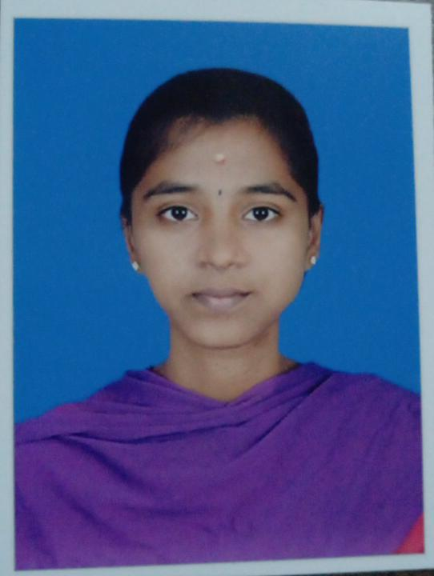
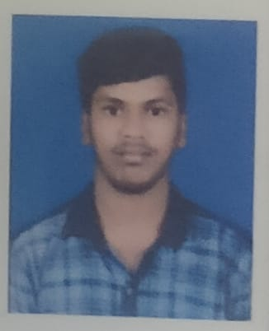
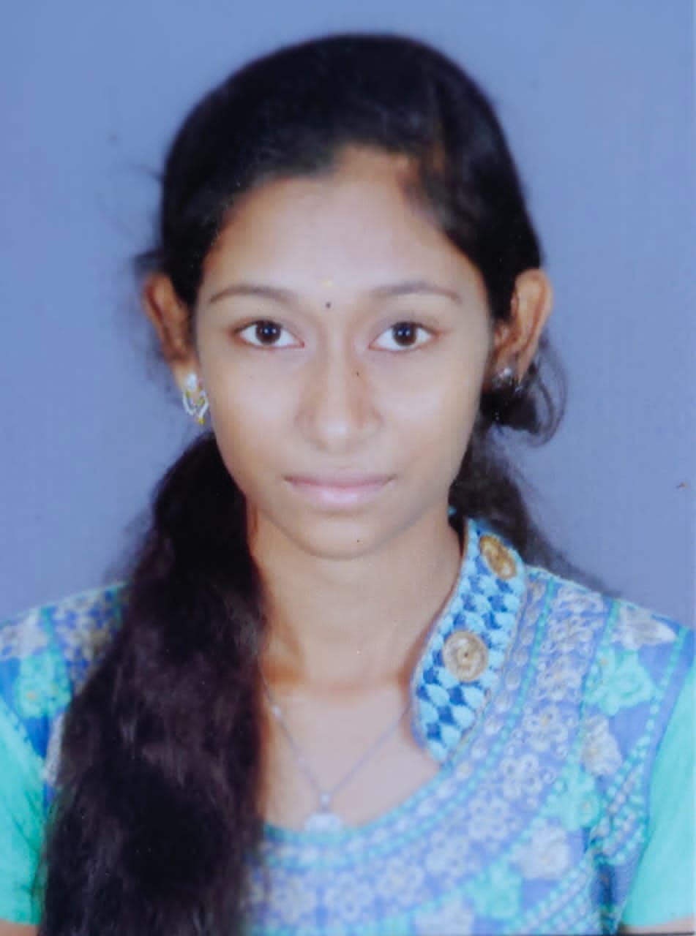
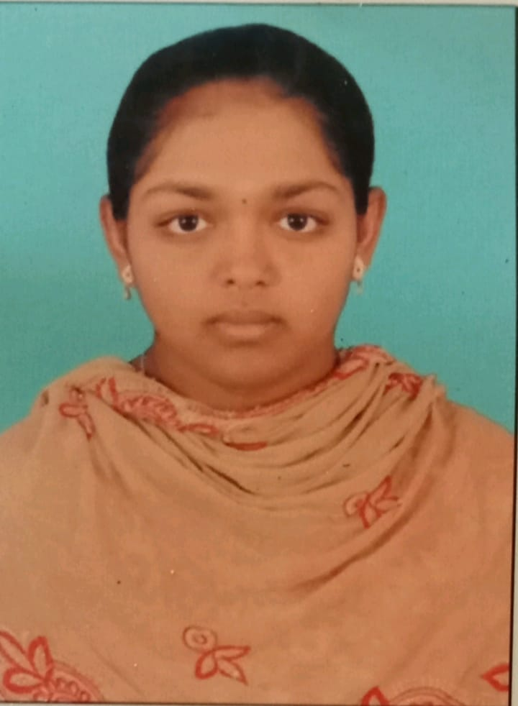
TEAM MEMBERS
PARAMASAKTHI G
TEAM MEMBER
SANTHOSH KUMAR K
DEIVANI A
TEAM LEADER
SNEHA S

Slide 4
LITERATURE SURVEY
YEAR | TITLE | AUTHOR(S) | TECHNIQUES | PROS | CONS
2018 | Blood donation and life saver-blood donation app | M.R. Anish Hamlin, J. Albert Mayan | Android, GPS, Cloud Computing | One-Time Password (OTP) is used to verify the donor, once the donor accepts the request. Once the donor donates the blood it will automatically remove the donor detail for next three months. | This application searches for donors only in the nearest areas.
2019 | D’WORLD: Blood Donation App Using Android | A. Meiyappan, K. Loga Vignesh, R. Prasanna, T. Sakthivel | Android, Global Positioning System (GPS), Mobile Computing | When the giver gives the blood, it will naturally evacuate the contributor detail for next three months. It additionally confirms with the Department of Health and Welfare to guarantee the benefactor medical case history. | When the giver gives the blood, it will naturally evacuate the contributor detail for next three months. It additionally confirms with the Department of Health and Welfare to guarantee the benefactor medical case history.
2020 | Lifesaver E-Blood Donation App Using Cloud | Rishab Chakrabarti, Asha Darade, Neha Jadhav, Prof. S. M. Chitalkar | E-health, GPS, Blood bank database, Cloud Computing | Reduction in the errors of blood bank using most eligible donor method. Direct Communication Between donor and the person in need of blood During the Emergency situation. | The user given details are maintained unverified.

Slide 5
2021 | BDoor App-Blood Donation Application using Android Studio | S Periyanayagi, A Manikandan, M Muthukrishnan, and M Ramakrishnan | Android, Flutter UI, Dart, Firebase, Decision tree algorithm | The Donor details are verified before they allow to donate and have to authorised by institution. The Verification and validation are done in Email base. | The Donor details are verified before they allow to donate and have to authorised by institution. The Verification and validation are done in Email base.
2022 | Instant Plasma Donor Recipient connector web application | Kalpana Devi Guntoju, Tejaswini Jalli, Sreeja Uppala, Sanjay Mallisetti | Web Technologies, API, Database | The Donor needs to upload their recovered COVID-19 Certificate and it required to verified by the blood bank. It is a user-friendly application. It will help people to find plasma easily | This is system is closed for general plasma donation and mainly focused on COVID-19 patients for plasma donation

